Slide 1
Kindergarten Management System

Slide 2
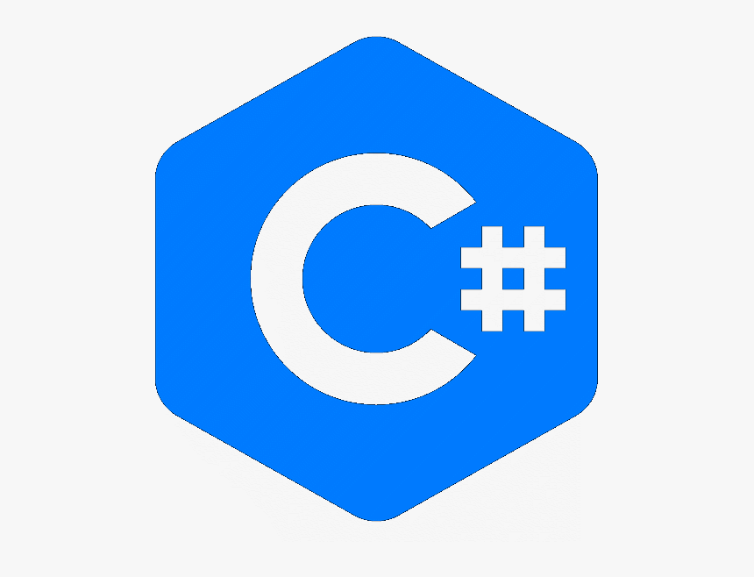


Abstract
What is a management system and why we need one ?
In every place and organization we need a system that we can use it to make our work and process easier management system are different from each other the main goal of most of a management system is to save data and show data and report.
Kindergartens like many places need a management system to make the whole daily process faster and easier
1

Slide 3
Introduction
How we created this management system what tool is used ?
It’s no doubt that every management system need a database to save user data and other daily works and data so a place like kindergarten need a scalable DBMS so we used sql server we need to know that day to day when we insert and save data our data get bigger and bigger so we must avoid slowness of the system by choosing right tool.
We used C# with a framework called guna to design the best user interface possible in windows form .
Used Entity Frameowrk For Database Modeling.
2

Slide 4
Aim of project
What are the aims of this project ?
To manage attendance of the child's .
To provide fast workspace for all the employee .
Easy room management .
With fast workspace and easy use we can now take a better care at the child’s and their health .
We can make report easily.
3

Slide 5

Database
Tables
tbl_address
tbl_child_disease
tbl_child_healthy
tbl_child_info
tbl_subject_activity
tbl_disease_type
tbl_employee
tbl_child_info
tbl_attendance
tbl_time_table
tbl_food
tbl_rooms
tbl_room_name
tbl_nurse
tbl_user
tbl_place_of_birth
tbl_sociologist
4

Slide 6
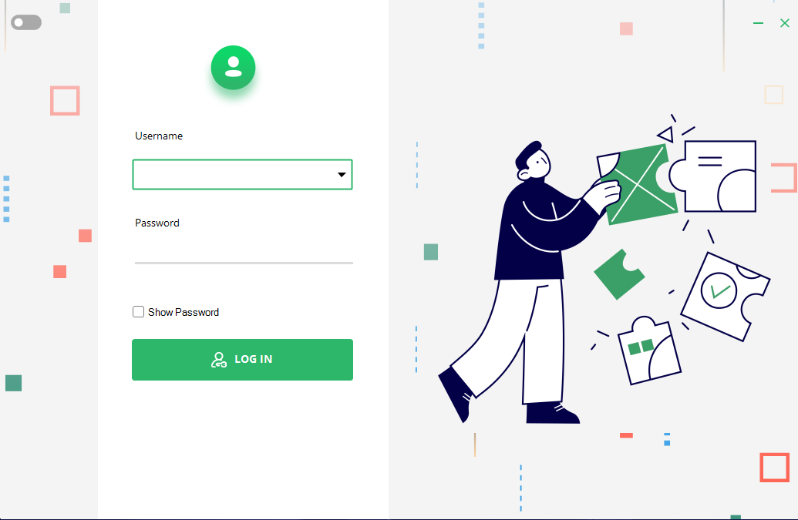
Screen shot of the forms
The login form :
When we start up the program we see the login user the username is a combo box it has the other recent user.
4

Slide 7
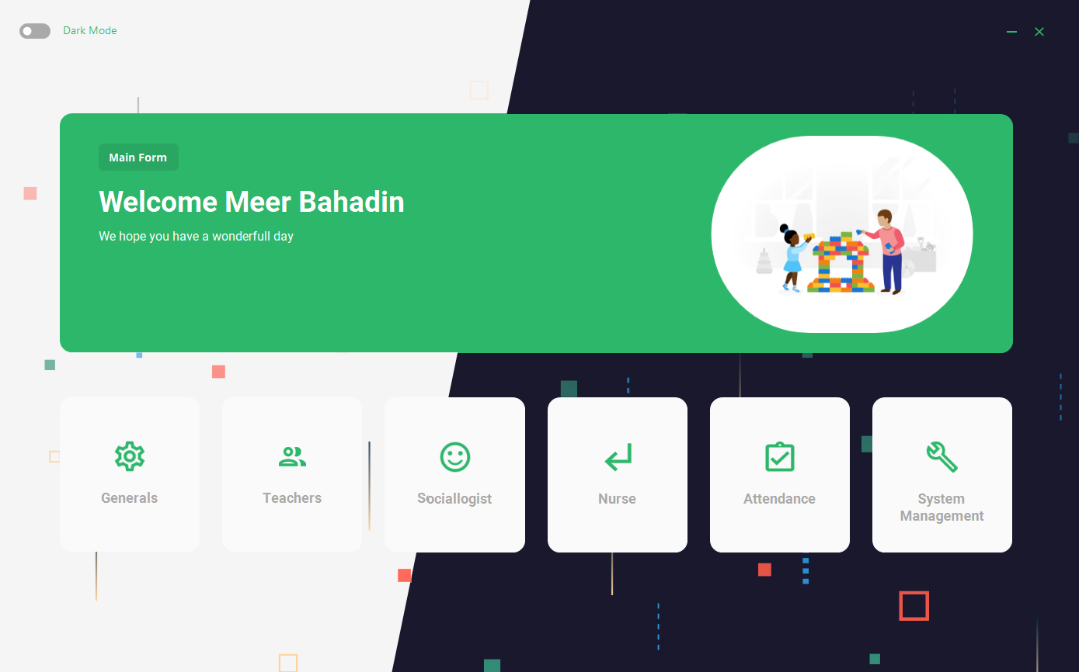
Screen shot of the forms
The main form :
From this form we can navigate to other forms ,
Offers Dark & Light Mode
6

Slide 8
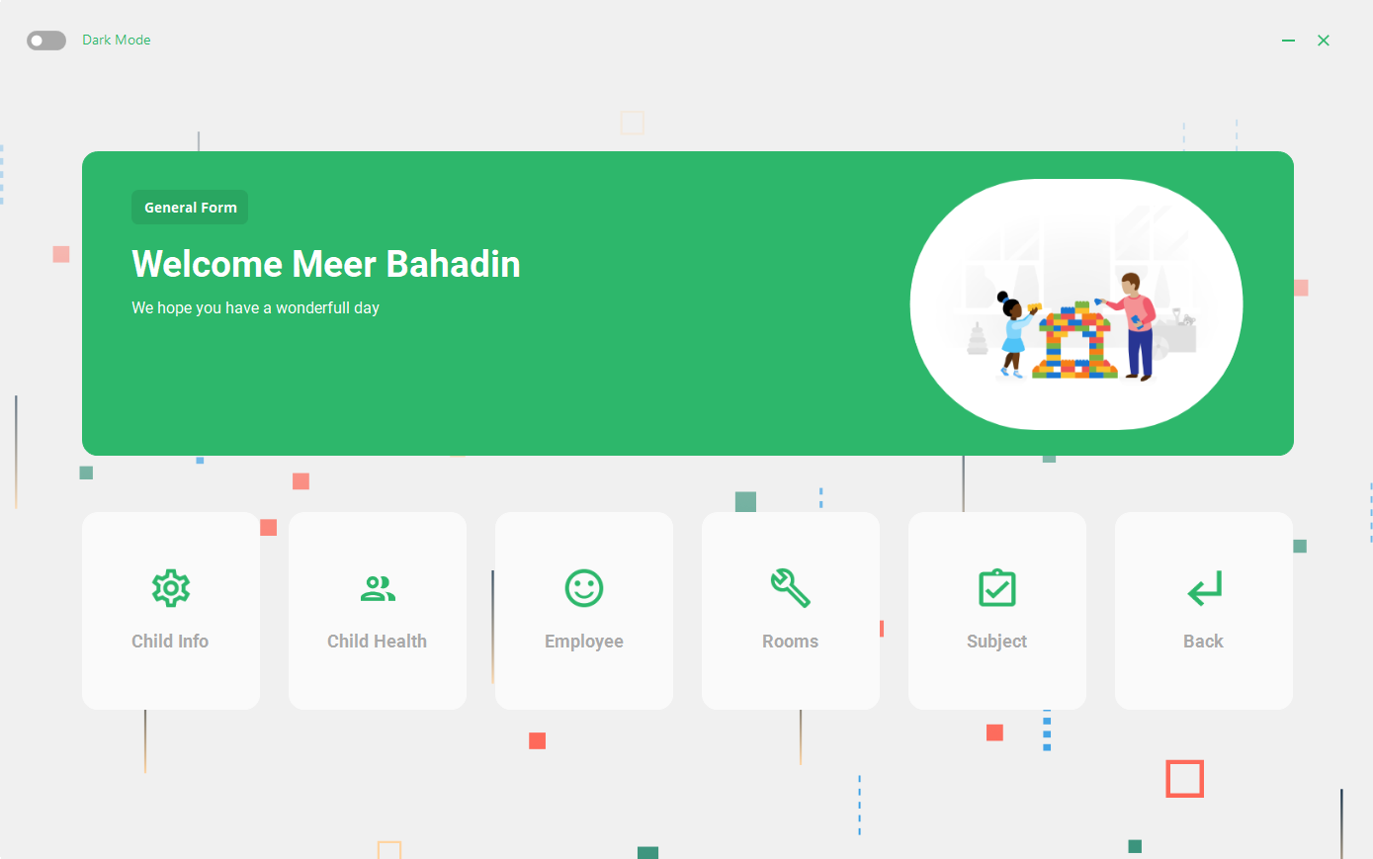
Screen shot of the forms
The general form :
The general form is more like the main form it has a button to other forms and the functionality of the program.
6

Slide 9
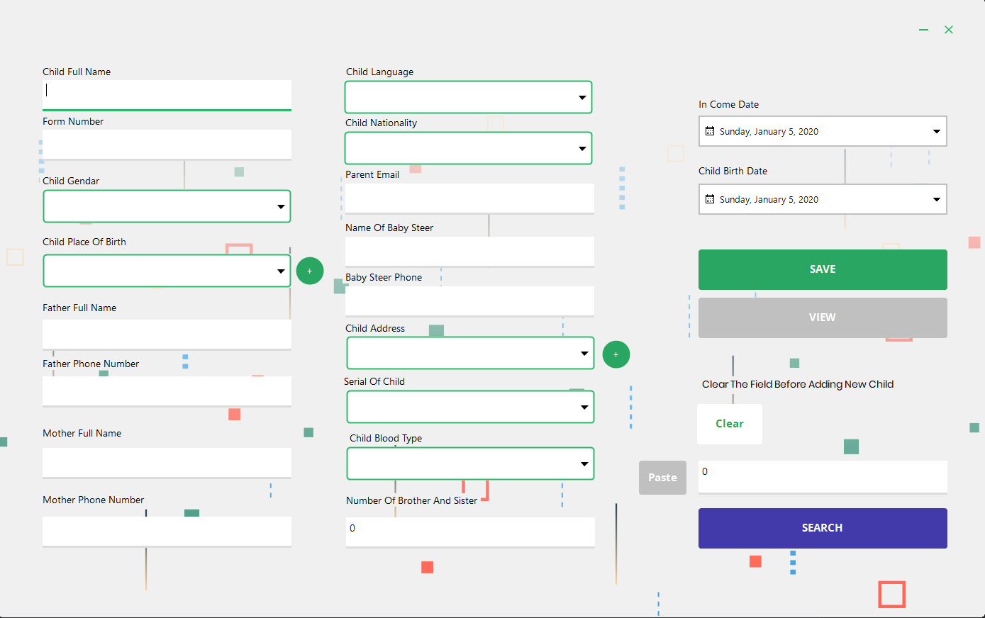
Screen shot of the forms
The child info form :
In this form we can insert new child
We can update a child data
When we click view it show us the data we can simply copy the id by just selecting the row and past it and search then we can update the data

Slide 10
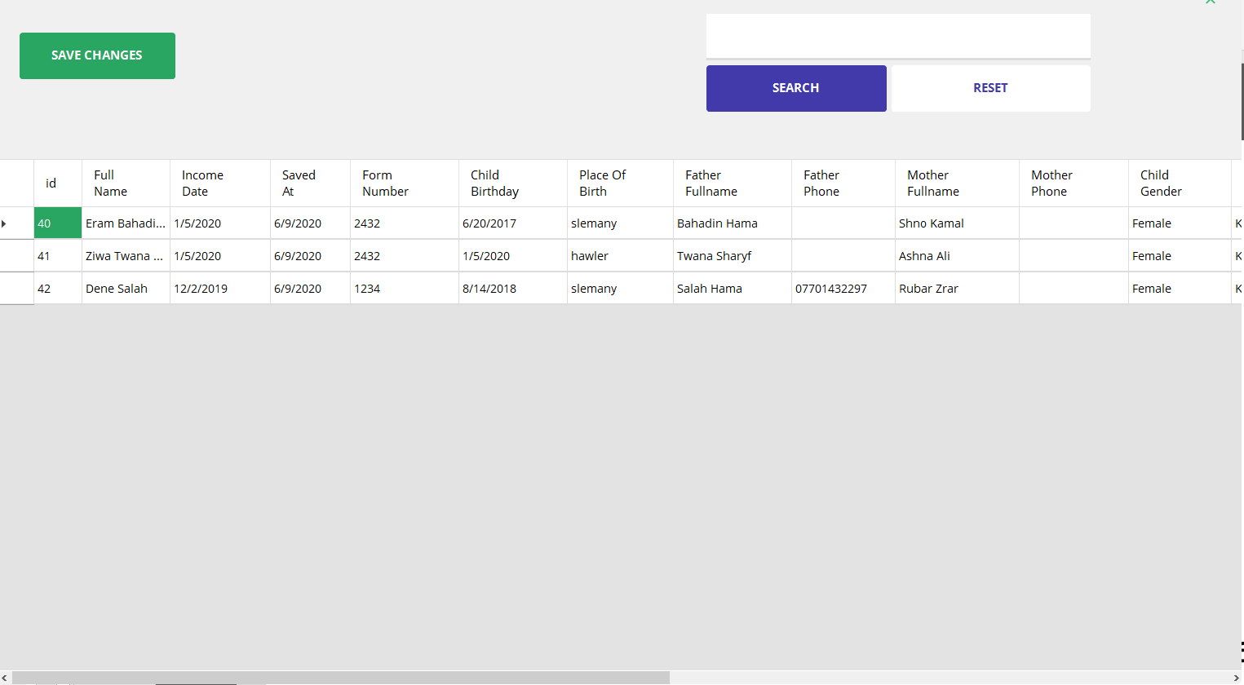
Screen shot of the forms
The view form :
We can click the row we want to edit the id automatically get copied then we can update it in the child info form we can also search for child data here.

Slide 11
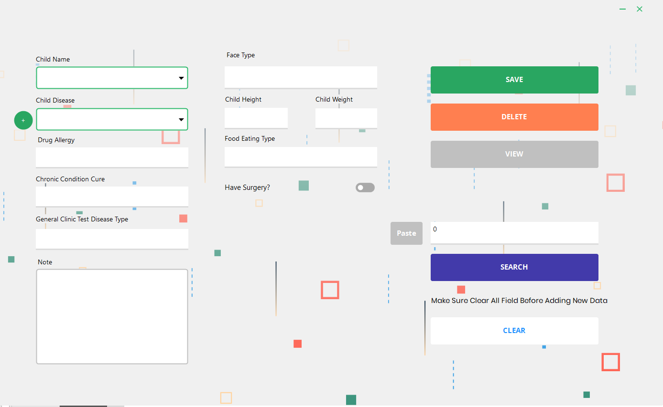
Screen shot of the forms
The child health form :
In this form we can add health data about the child.

Slide 12
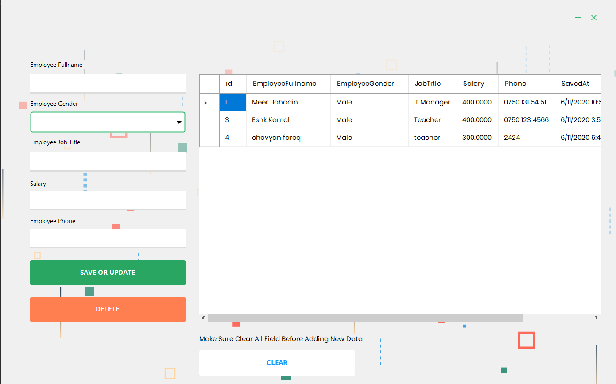
Screen shot of the forms
The Employee form :
In this form we can add new
, update , delete Emplooye

Slide 13
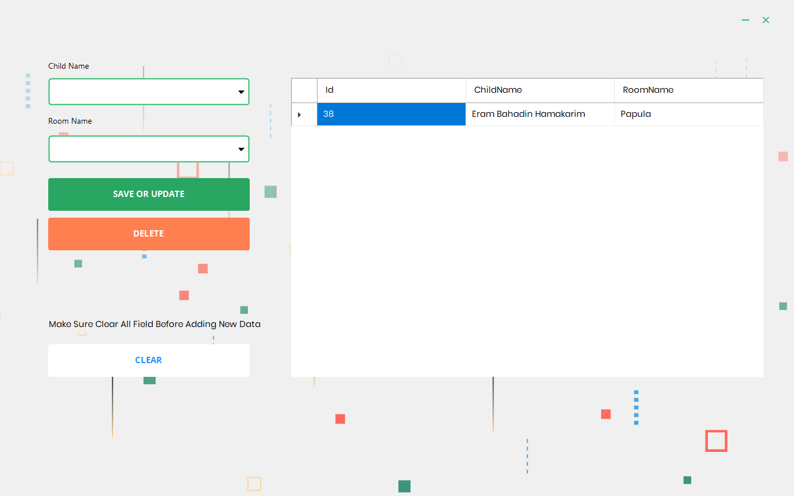
Screen shot of the forms
The Rooms form :
In this form we can category each child name by its room.

Slide 14
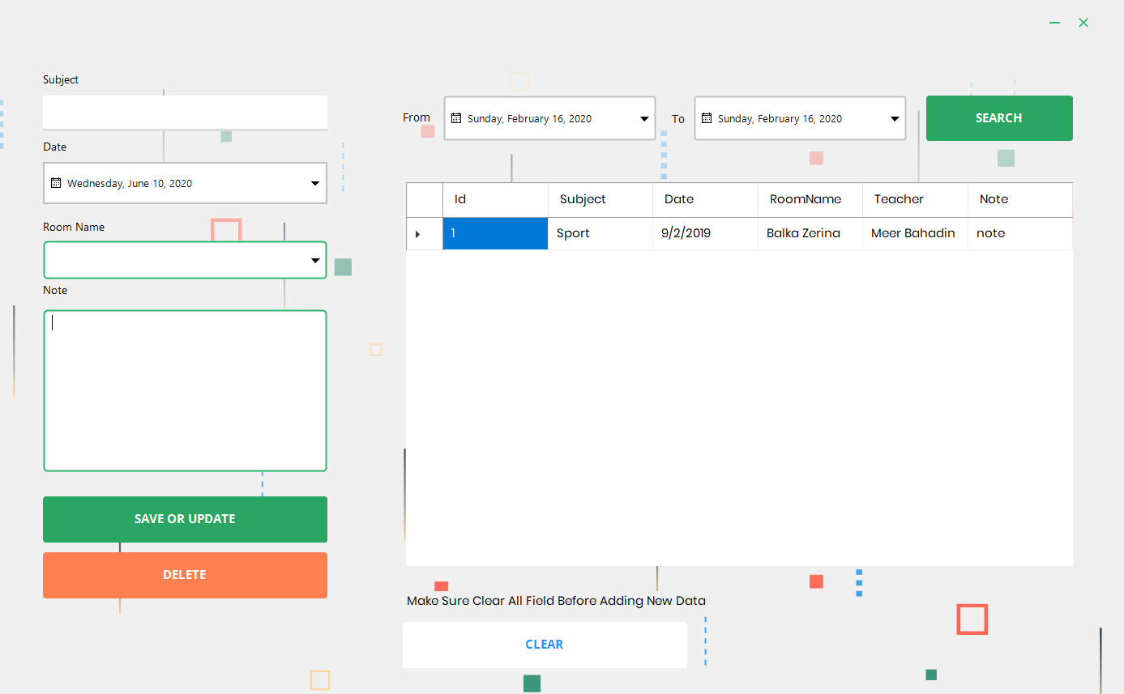
Screen shot of the forms
The Teachers form :
In this form a teacher will save a
Day task about the subject he/she told in class.

Slide 15
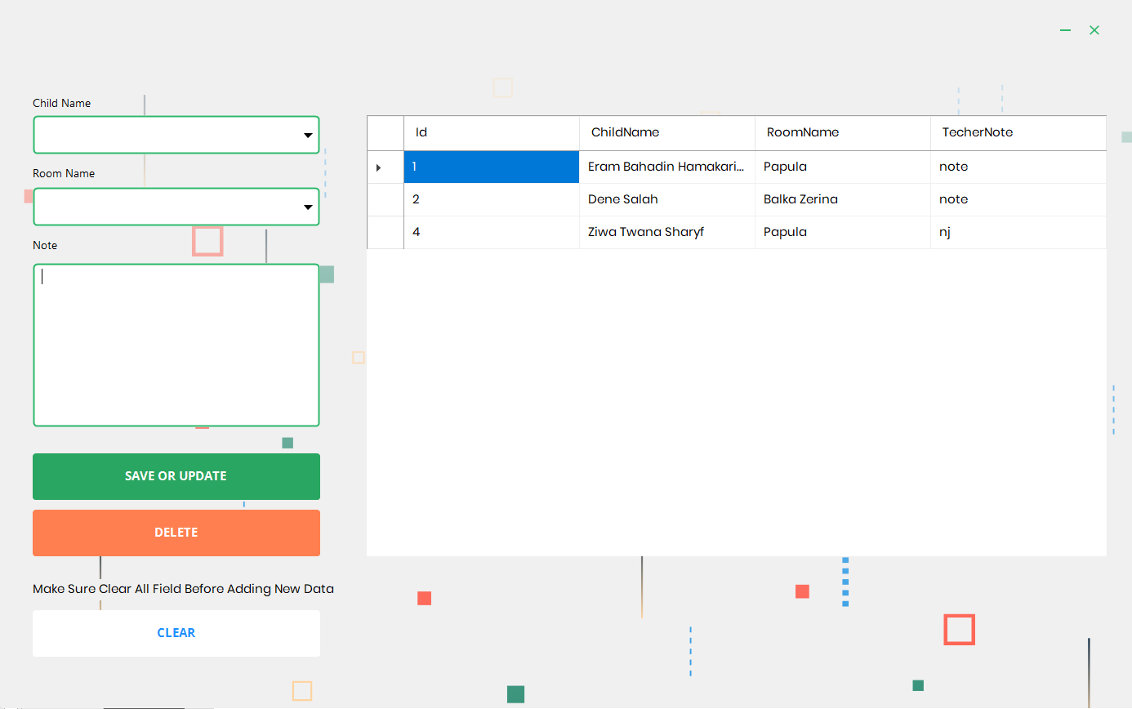
Screen shot of the forms
The Sociologist form :
In this form a sociologist can
Add note about mental health of
The child's.

Slide 16
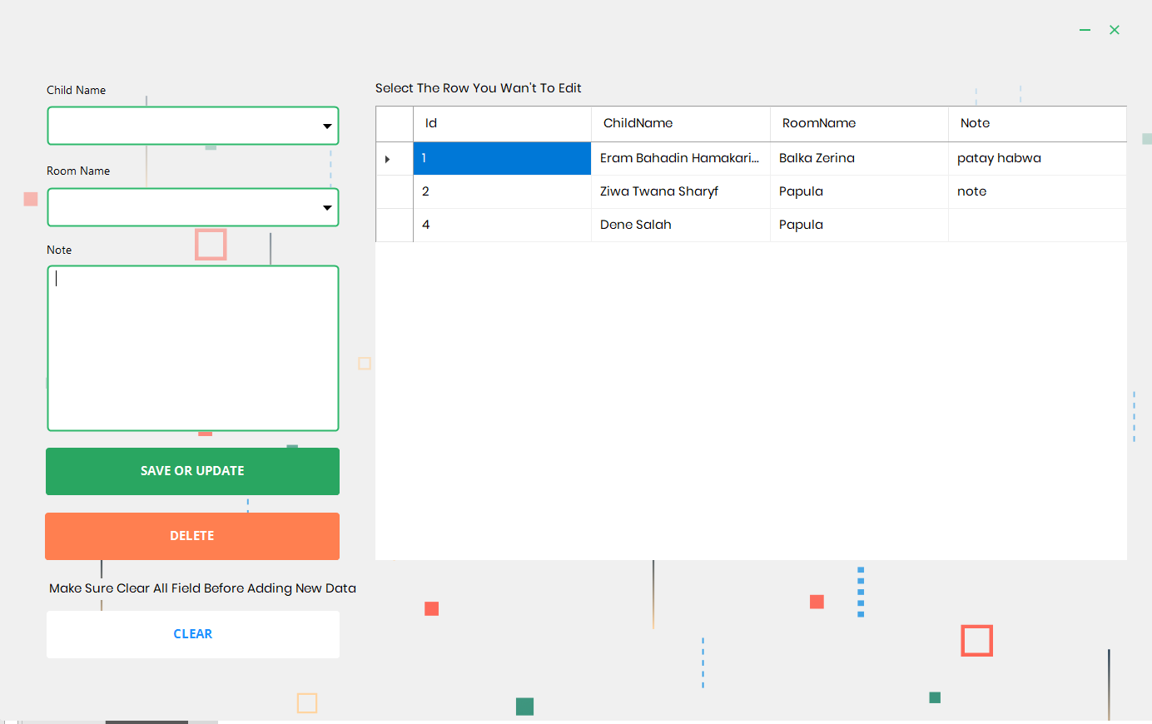
Screen shot of the forms
The Nurse Form :
In this form a nurse can add
A health information about
Child.

Slide 17
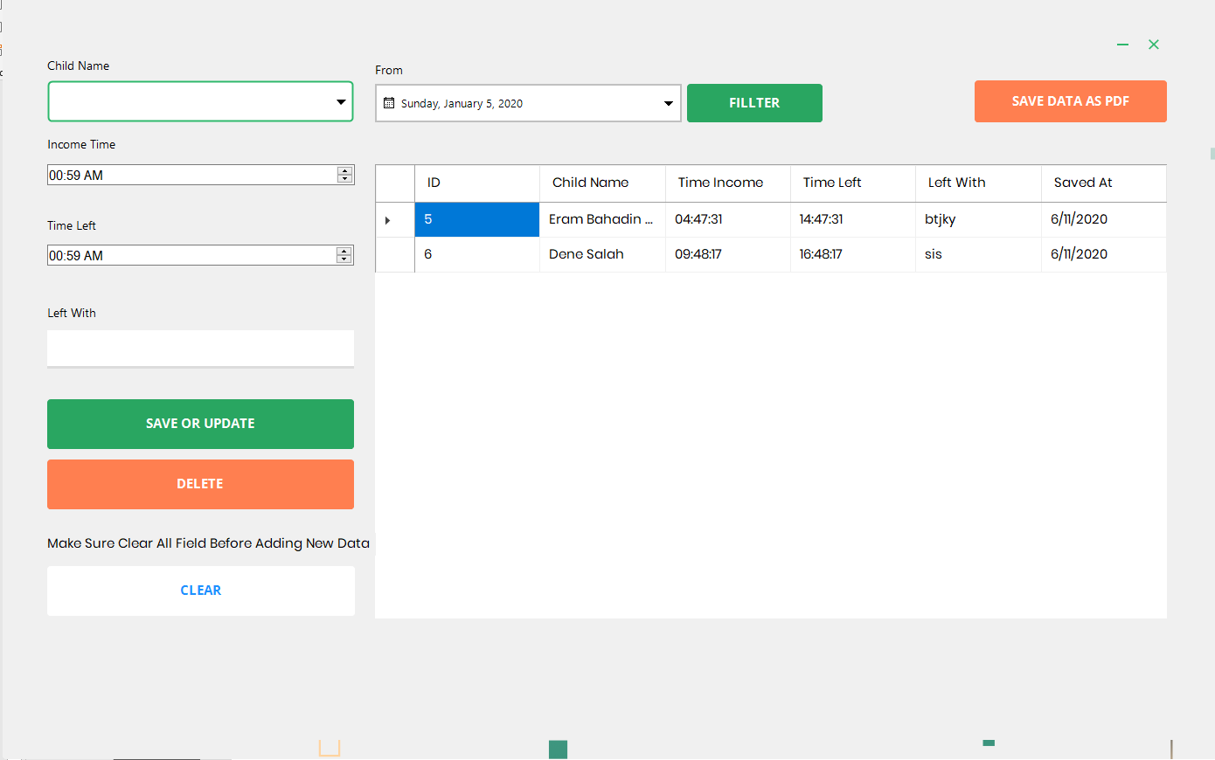
Screen shot of the forms
The Attendance Form :
In this form a teacher can manage
Attendance insert and update delete attendance and filter it then save it as pdf.

Slide 18
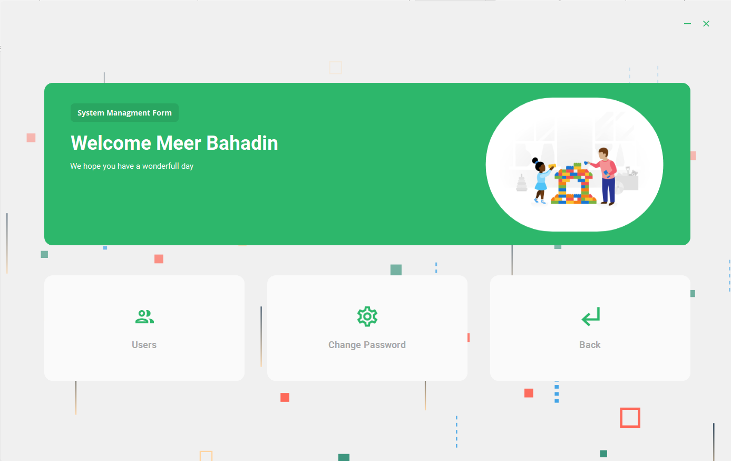
Screen shot of the forms
The System Management Form :
Finally the system management form in this form Admin can add or remove user and user can change their own password.

Slide 19
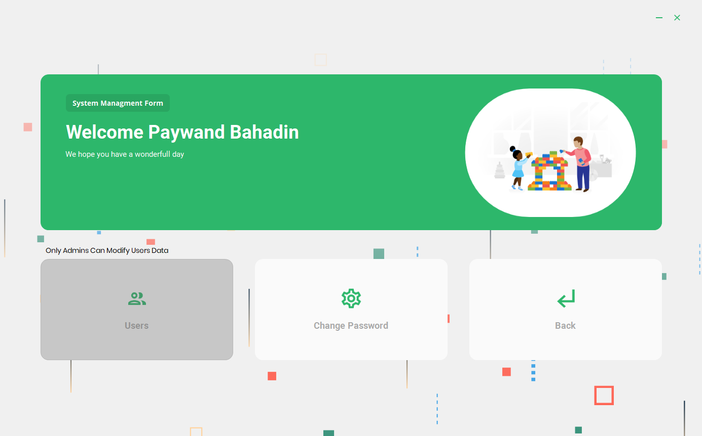
Screen shot of the forms
The System Management Form :
If your not an admin you cant enter the users form.

Slide 20
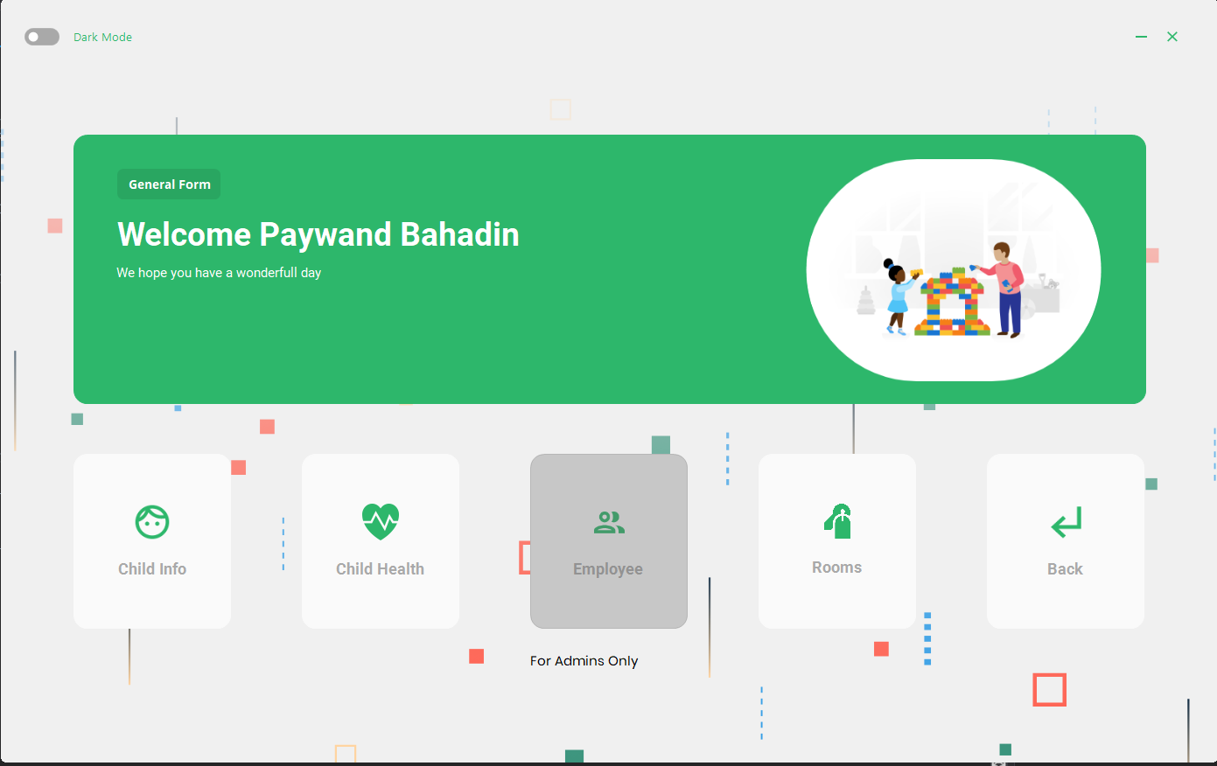
Screen shot of the forms
The General Form :
And also if you're not an admin
You can’t modify employee data

